Slide 1

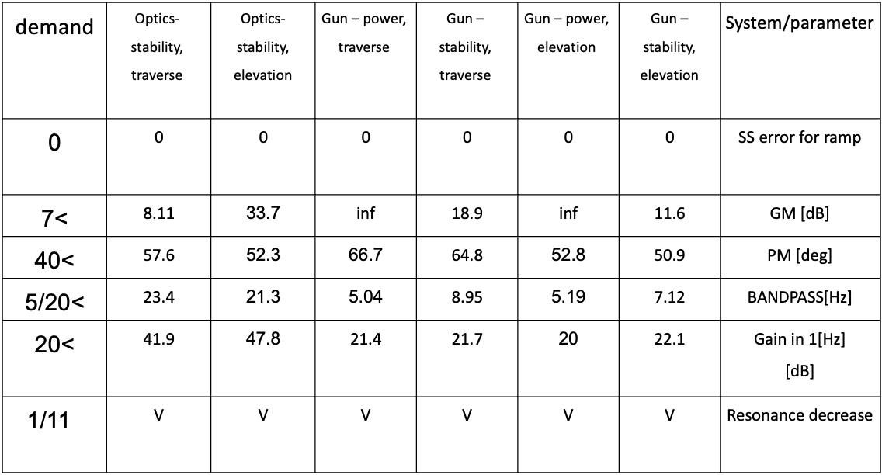
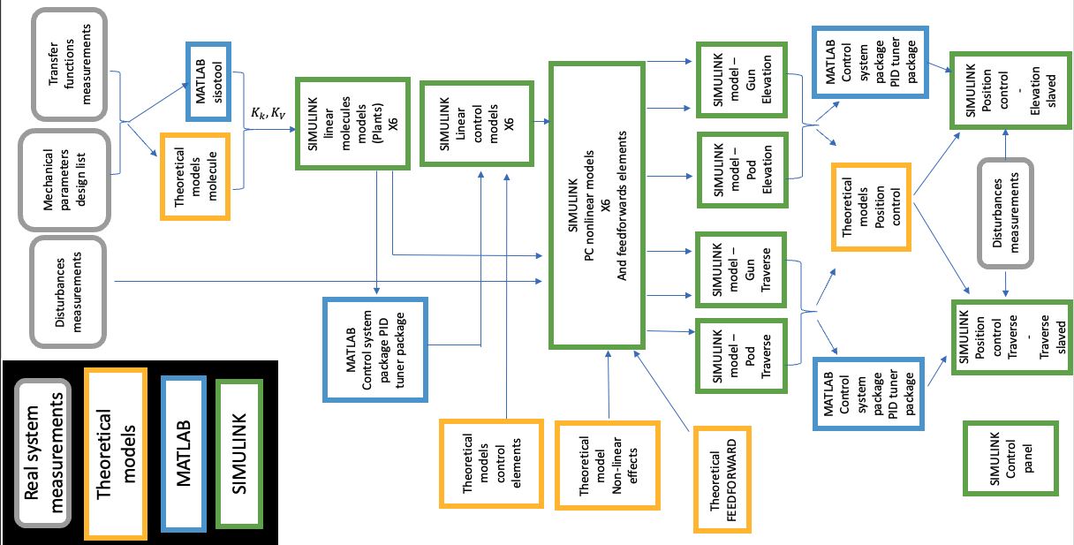
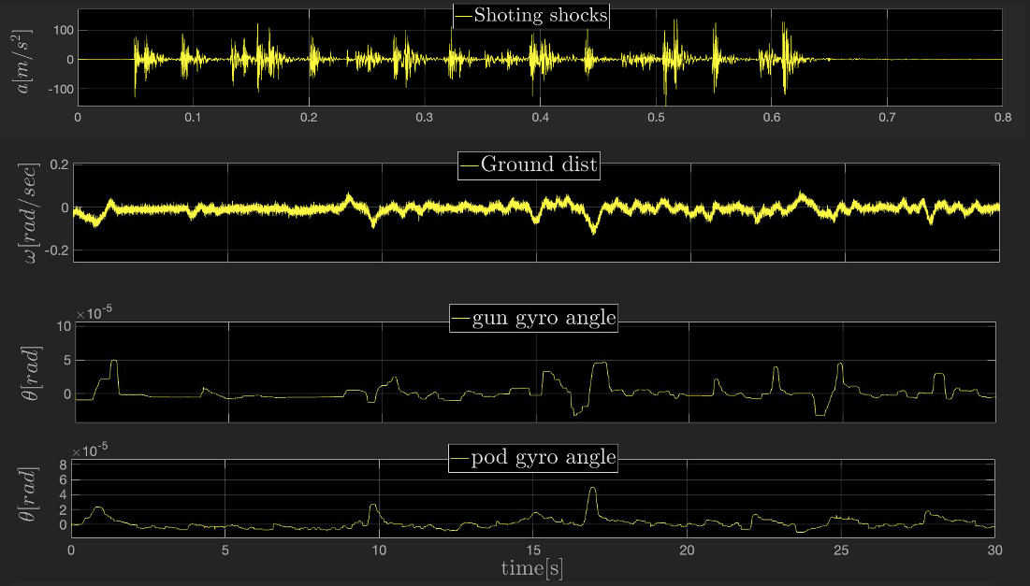
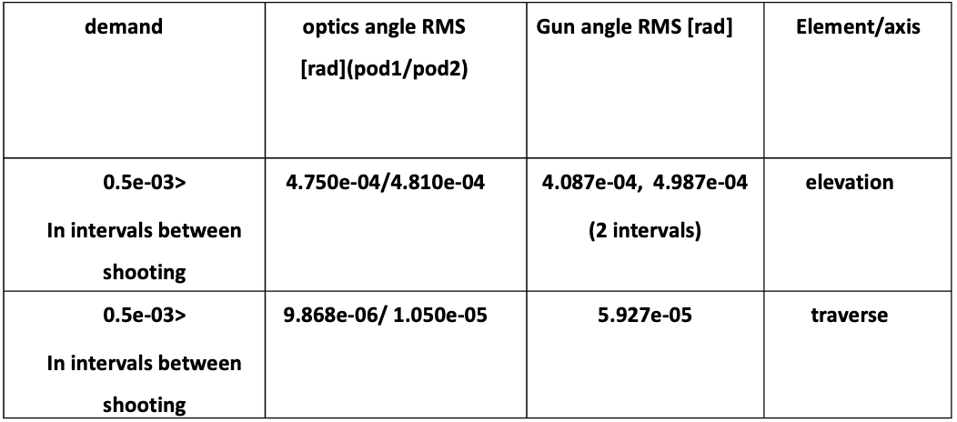
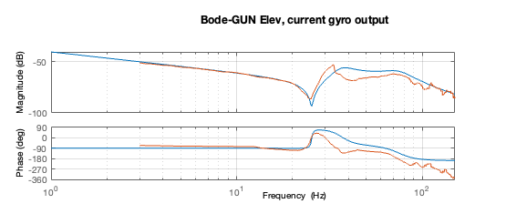
Simulator of a mechanical system – mobile observation and gun post
Project Number: 22-2-1-2206
Name: Ohad Forman
Advisor: Dr. Gavriel Davidov
Introduction Simulator of a mechanical system of a moving observation and gun post as been built, based on: measurements of the transfer functions of the real system from input command to strategically placed sensors measurements of the system under shooting and ground disturbances mechanical parameters of the system. The simulator includes: Controllers designed to meet stability effectiveness of stabilization demands Non-linear effects, un-balance and coulomb friction Feedforward elements to improve the goodness of stabilization result, reduce the error cause by friction, shooting and ground disturbances. Slavery position control system, for the following of the gun after the optics position (angle) state The simulator build on SIMULINK Platform. Motivation A reliable simulator based on a good simulation of the mechanical system to provide a good predictor of the behavior of the real system. Saving in resources of time/money, from less field tests on the real system Check for the possibility for a wanted performances for a given mechanical system in terms of stability and balance. being an advisor for changes in the real system for the mechanical engineer to meet the demands wanted. Implementation 6 sub-systems have been simulated based on the real system measurements and parameters of the optics and gun systems. for the gun system, 2 axis-Elevation and Traverse, 2 operation modes per axis , Power and stability, and 2 stability operation mode for 2 axis of the optics system. Using newtons dynamics principles models and unknown coefficients estimation for stiffness and damping of the systems Simulation (blue) vs. measurements (orange) bode—Elevation, stability mode | For the 6 sub-systems, Controllers have been built to meet the stability criteria non-linear effects as theoretically planed and implemented to the Simulink models The system as tested under disturbances measurements on the real system, and been calibrated to stand in the effectiveness of stabilization and stability criteria A feedforward techniques as been implemented to decrease errors from friction, ground disturbances and set point The gun system as been slaved to the optics system to follow the position state (angle) of the optics system. All the above using: Theoretical developments, SIMULINK and MATLAB tools implementation hierarchy Results The simulator: simulator of elevation axis (controlled by a control panel, not in the figure) ©photos from Dr. Gavriel Davidov “Control 2” course presentation and parameters system list | Stability results: stability results table effectiveness of stabilization results: From top - traverse axis shooting shocks, ground disturbances, gun angle, optics angle effectiveness of stabilization results table Conclusions Complex non-linear mechanical system can be simulated using newtons dynamics principles method and non-linear models for coulomb friction and unbalance Feedforwards techniques improve the system performances in terms of goodness of stabilization The dynamics of the optics system produce a better stability performances, from that the gun slave to the the optics causes an improvement in the performances overall Bibliography [1] G. Davidov, " SELECTED TOPICS OF THE SYNTHESIS AND ANALYSIS OF ALL-ELECTRIC HEAVY GUN/TURRET DRIVE CONTROL SYSTEMS", conference paper: THE FIRST INTERNATIONAL CONFERENCE ON ALL ELECTRIC COMBAT VEHICLE (AECV), HAIFA ISRAEL DAN-CARMEL HOTEL, May 1995

